Slide 1
Quantitative Research
By
Temtim Assefa
October, 2013

Slide 2
Research Design
It is the entire design of the research project
It is said as the research proposal
It involves deciding on all aspects of the research process
That includes
Philosophical assumption
Research method
Data collection techniques
Data analysis
Publication outlet if possible
It matters to get your proposal accepted or rejected

Slide 3
Overview of Quantitative Research
Uses deductive method of knowledge acquisition
Intends to falsifies an existing theory
Tries to generate generalizable knowledge
Accepts objectivity of knowledge
Uses a standard measurement instruments
The researcher is independent in the process of knowledge construction
Quantifies the phenomena in terms of numbers
Intends with prediction and controlling

Slide 4
Research Designs …
Descriptive X? Y? Z?
What is X, Y, and Z?
Correlational r_{xy}
Is there a relationship between X and Y?
Causal ΔX  ΔY?
Does a change in X cause a change in Y?

Slide 5
Descriptive
Focus on Descriptive studies concerned with answering who, what, when, how questions
Examples
Do teachers hold favorable attitudes toward using computers in schools?
What kinds of activities that involve technology occur in sixth-grade classrooms?
What have been the reactions of school administrators to technological innovations in teaching the social sciences?
How high school computing courses changed over the last 10 years?
How do the new multimediated textbooks compared to the print-based textbooks?
How many in house software developed in Ethiopia?
It is undertaken to fill the information gap about the phenomenon

Slide 6
Descriptive ..
Descriptive statistics such as measures of central tendency, variation, and correlation are used for data analysis.
Descriptive research might simply report the percentage summary on a single variable.
Examples of this are the tally of reference citations in selected instructional design and technology journals by Anglin and Towers (1992)

Slide 7
Classification of Descriptive Studies
Longitudinal | Cross-Sectional
the true panel the single measures over time | field studies/surveys
Longitudinal Surveys
Provides a series of pictures that, when pierced together, provide a movie of the situation about the changes that are occurring.
The sample remains relatively constant through time and the sample members are measured repeatedly.
Cross-Sectional Studies
Provides a snapshot of the variables of interest at a single point in time.
The sample is typically selected to be representative of some known universe.

Slide 8
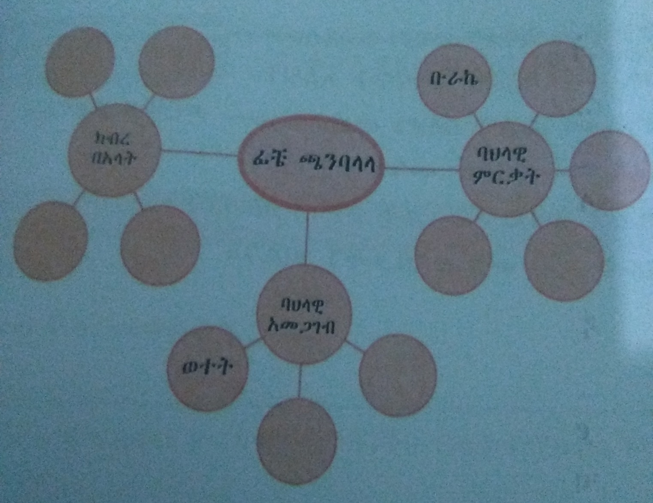
Descriptive Research
Adapted from Amharic Text book, AACA

Slide 9
Example of Descriptive Research – Data mining
Data mining
Predictive
Decision tree
Statistical methods
Descriptive
Clustering
Association rules
Regression
ANN
J48
Random Forest
Part Rule

Slide 10
Construct a Descriptive research model for IS problem?

Slide 11
Correlation research
It tries to investigate the association between two variables.
However one variable is not the cause for the other variable
The two variables occurring at the same time
For example, the association between season and rainfall such as summer season
Example
Is there association between software success and organization type?
Is there association between security threat and organization type
Is there association between student performance and gender type?

Slide 12
Explanatory research
Intended to establish relationship between independent and dependent variables.
It is referred to as causal research
Changes in the independent variable determines changes in the dependent variable but not in the reverse way
there is temporal difference in variable occurrence
Example:
What factors predict software success?
What factors predict software usability?
Why users adopt cloud computing solutions?
Why users involvement in system development create conflict?

Slide 13
Explanatory Requires Conceptual Framework
Participation
Conflict
Conflict resolution
Influence
Conceptual Framework of User Involvement in system development

Slide 14
Can you create a casual research model that predicts IS Success?
Create a model that shows social networking tools impact on student performance

Slide 15
Quantitative research procedures
Clarify the research problem
Develop conceptual framework if explanatory design
Decide what type of survey design is appropriate
Decide what type of sample design and sample size is most appropriate
Decide the data collection methods and design the questions and test your instruments
Undertake the fieldwork and data collection
Undertake data analysis and interpret your results
Disseminate your findings

Slide 16
Research Process
Problem
Liter. review, Conceptual FW,
Data Interpretation
Research Design
Data Collection & Analysis
Develop Instrument

Slide 17
Data Collection Instrument Design

Slide 18
Instruments
Instruments are tools that are used to measure variables
There are different types of instruments
Questionnaire
Structured interview
Observation checklists
Dairy
Archival documents
Photographs, etc

Slide 19
Questioners
Most frequently used measurement instrument in organization studies
Includes sets of questions to which the subject responds
It is used to measure:
Attitude
Opinions
Demographic characteristics of the subjects

Slide 20
Questionnaires
Common design of questionnaires are checklists and rating scales
Check list is a list of behaviors, characteristics or other entities that a researcher is investigating
Either the researcher or participants simply check(s) items from the list
What are features of user friendly software
Graphical interface
Clear navigation direction
Immediate feedback
Other specify ____________

Slide 21
Questionnaire …
A rating scale is more useful when a behavior, attitude, or other phenomena of interest needs to be evaluated on a continuum scale
It is designed with the following scales
“inadequate” to “excellent”,
“never” to “always” or
“strongly disapprove” to “strongly approve”

Slide 22
Example of Questionnaire
There is huge amount of information stored in the organization. Accessing the required information is a challenge to make evidence based decision. The organization introduces a database system to solve the problem.
Why did you decide to use the data base system (checklist)
Thought it was required
Increases access to organization information
To improve collaboration with other employees
To avoid or lesson errors on the task
Reduces my work burden
Other specify
Do you believe that data base system improves information access in your organization (rating scale)
Strongly Approve Neutral Disapprove Strongly
Approve disapprove

Slide 23
Guideline for Questionnaire
Keep it short
What do I do with the information?
Is it absolutely essential to have this information to solve part of the research problem
Use simple, clear, unambiguous language
Check for unwarranted assumptions implicit in your questions
How many cigarette do you smoke each day?
Good to add a choice
25 ___ 25-16 ____ 15-5 ___ <5 ____ None ____
Word your questions in ways that don’t give clues about preferred or more desirable responses
What strategies have you used to try to quit smoking?
Leads him to list strategies he did not try

Slide 24
Guide line …
Check consistency – that leads to give contradictory answer for two questions
Determine in advance how you will code the response
Keep the respondents task simple
Provide clear instructions
Make the questionnaire attractive and professional looking
Conduct a pilot test
Give for half a dozen friends to see they have difficulty understanding any items
Scrutinize the almost final product carefully to make sure it address your needs

Slide 25
Develop a research model ERP system success and then develop a Questionnaire based on your research model

Slide 26
Data collection
Train data collectors if you hire data collectors
Follow the data collectors on the site
Check filled questioners for immediate correction in the field
Data collectors may fill false data without going to the selected sample
Check filled questionnaires with randomly selected respondents

Slide 27
Advantage of Questionnaire
Easily to collect data from large number of people, including those who live thousands of miles away
Can be administered by unskilled data collectors
Presents a uniform stimulus to all subjects
Can be collected online or through mail
Researcher does not have contact with the respondents
The anonymity of the respondents helps respondent to provide more truthful information than they would be in personal interviews, especially on sensitive and controversial issue

Slide 28
Draw back of questionnaire
Majority of people may not return, if it is mailed the return rate is not more than 50%
Returned responses may not be a true representative of the originally selected samples
Cannot be used with illiterate or persons who cannot read
Most questioners are inflexible, respondents answer by choosing only from the given lists

Slide 29
Interviews
Interviews are meetings in which the interviewers directs questions at the interviewee and records the obtained responses
It is direct face to face interactions
Can be undertaken through telephone
Help to captured more detailed information than questioners
Allow to include the respondents views

Slide 30
Design of Interview
Can be structured and unstructured
Unstructured interview is designed with open ended questions
The researchers asks and the responds reply to the questions
The same questions may not be asked for different respondents
Examples
Can you list down the benefit of the new software for your organization?
What are the main drawbacks of the new software?
What do you suggest to improve software to solve the current problems?

Slide 31
Structured interviews
The researcher asks standard set of questions and nothing more
In semi structured interview, the researcher may follow the standard questions with one or more individually tailored questions to get clarification or probe a persons reasoning
In structured interview, you can have checklist of responses
Example
What are the benefits of LAN in the organization
Facilitates communications among employees
Improves information access
Improves relationship with customers
Other specify
What kind of the support the management provides to the success of the Intranet system

Slide 32
Conducting Interview
Make sure that the interviewees are representative of the population
Find suitable location
Get written permission
Establish and maintain rapport
Focus on the actual rather than the abstract and hypothetical
Don’t put words in people’s mouths
Keep your reaction to your self
Good to use also Recording devices like Sony Voice recorder

Slide 33
Advantages of Interview
Interview is formal and emotionally neutral
Help to develop hypothesis at early stage of the research than testing hypothesis
It has a distinct advantage of establishing rapport with potential participants and gain cooperation
Has higher response rate
Flexible to include additional views and opinions
Has better validity, the researcher can further ask probing questions on some biased response

Slide 34
Develop an Interview check list to collect data why students use Facebook regularly?
Write a report based on the interview data you have collected. It must be submitted to the Google classroom

Slide 35
Disadvantage
It is generally expensive than other data collection methods
The researcher is the main interviewer otherwise training of interviewer is very expensive and time taking
The interviewer presents the questions in different manners that lead to different responses – affects the validity and reliability of the data
Characteristics of the respondents (age, sex, ethnicity, etc) may affect the value of measured variables
Respondents may not free on some controversial issues

Slide 36
Summary
Quantitative research is used for theory testing type of research.
There are different types of quantitative research design
Selection of research design depends on the type of the research problem
The researcher is independent in the knowledge construction process
Questionnaire survey is the main data collection method

Slide 37
Review questions
What are the main feature of quantitative research method?
What are the three types of quantitative research design?
What is causal research design?
What is research model or conceptual framework?
What is data collection instruments?

